Slide 1
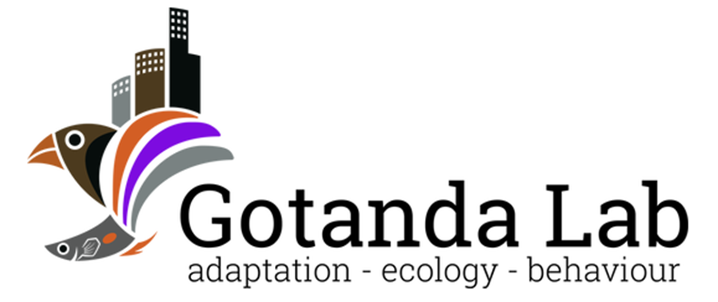

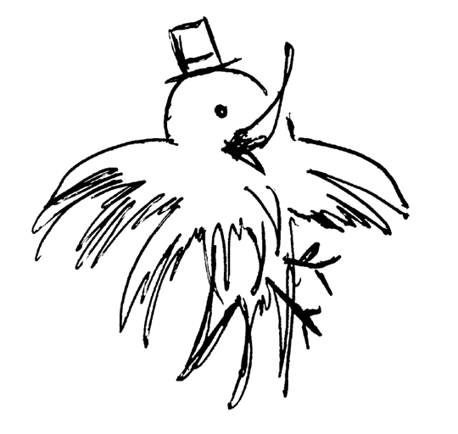
Heads Up!
Social Vigilance Behavior in American Crows
Alex Popescu, Dr. Kiyoko M. Gotanda, Dr. Anne B. Clark
OE3C 2023
Brock University

Slide 2
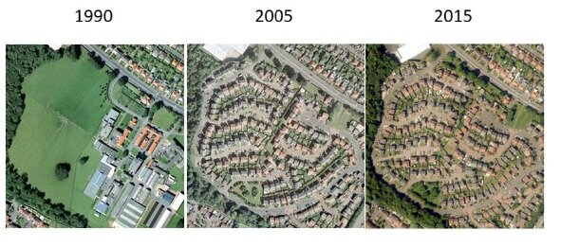
Urbanization
The shift in human population from rural to urban areas
An example of urbanisation in Edinburgh 1990 to 2015 Credit: CEH
Notes:
~55% of world population currently concentrated in urban areas, with the UN projecting that number to climb to 68% by 2050.

Slide 3
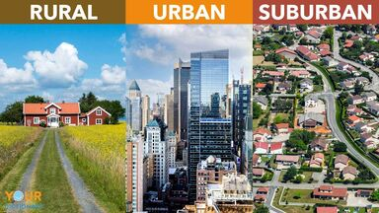
Urbanization
Leads to changes in the environment:
↓ Lines of sight
↑ Human-animal interactions
↓ Green spaces
Has negative effects on many species; associated with the global loss of biodiversity
https://examples.yourdictionary.com/identifying-difference-between-rural-urban-suburban
Kowarik I. 2011 Novel urban ecosystems, biodiversity, and conservation. Environ. Pollut. 159

Slide 4
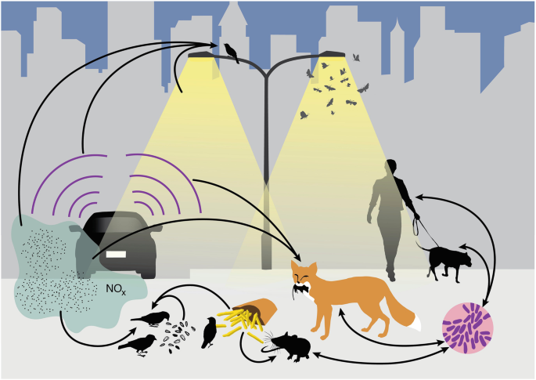
Can species be successful in cities?
Yes!*
* Will depend on species’ traits
Advantageous traits:
Adaptability
A generalist nature
An omnivorous diet
Intelligence
Isaksson, C. (2018). Impact of Urbanization on Birds. In: Tietze, D. (eds) Bird Species
Patankar S et al. 2021 Which Traits Influence Bird Survival in the City? A Review. Land 10

Slide 5
Can species be successful in cities?
Some advantageous adapted behaviors in urban areas:
Modified diet
↑ Interspecific aggression
↑ Tolerance of risks
↑ Tolerance of human proximity
Isaksson, C. (2018). Impact of Urbanization on Birds. In: Tietze, D. (eds) Bird Species
Luniak M. 2004 Synurbization - adaptation of animal wildlife to urban development. 50–55

Slide 6
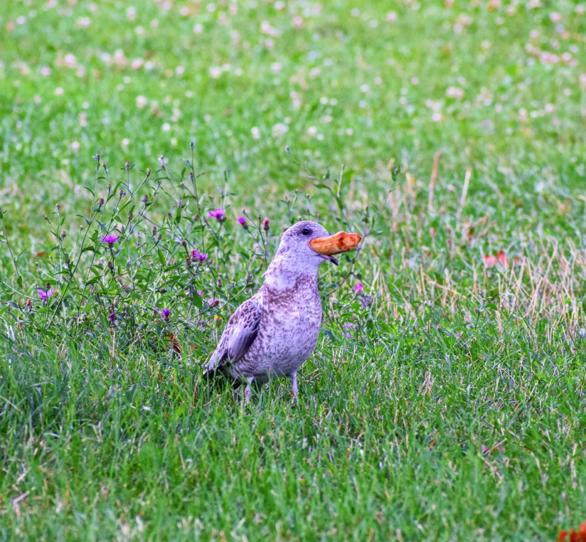
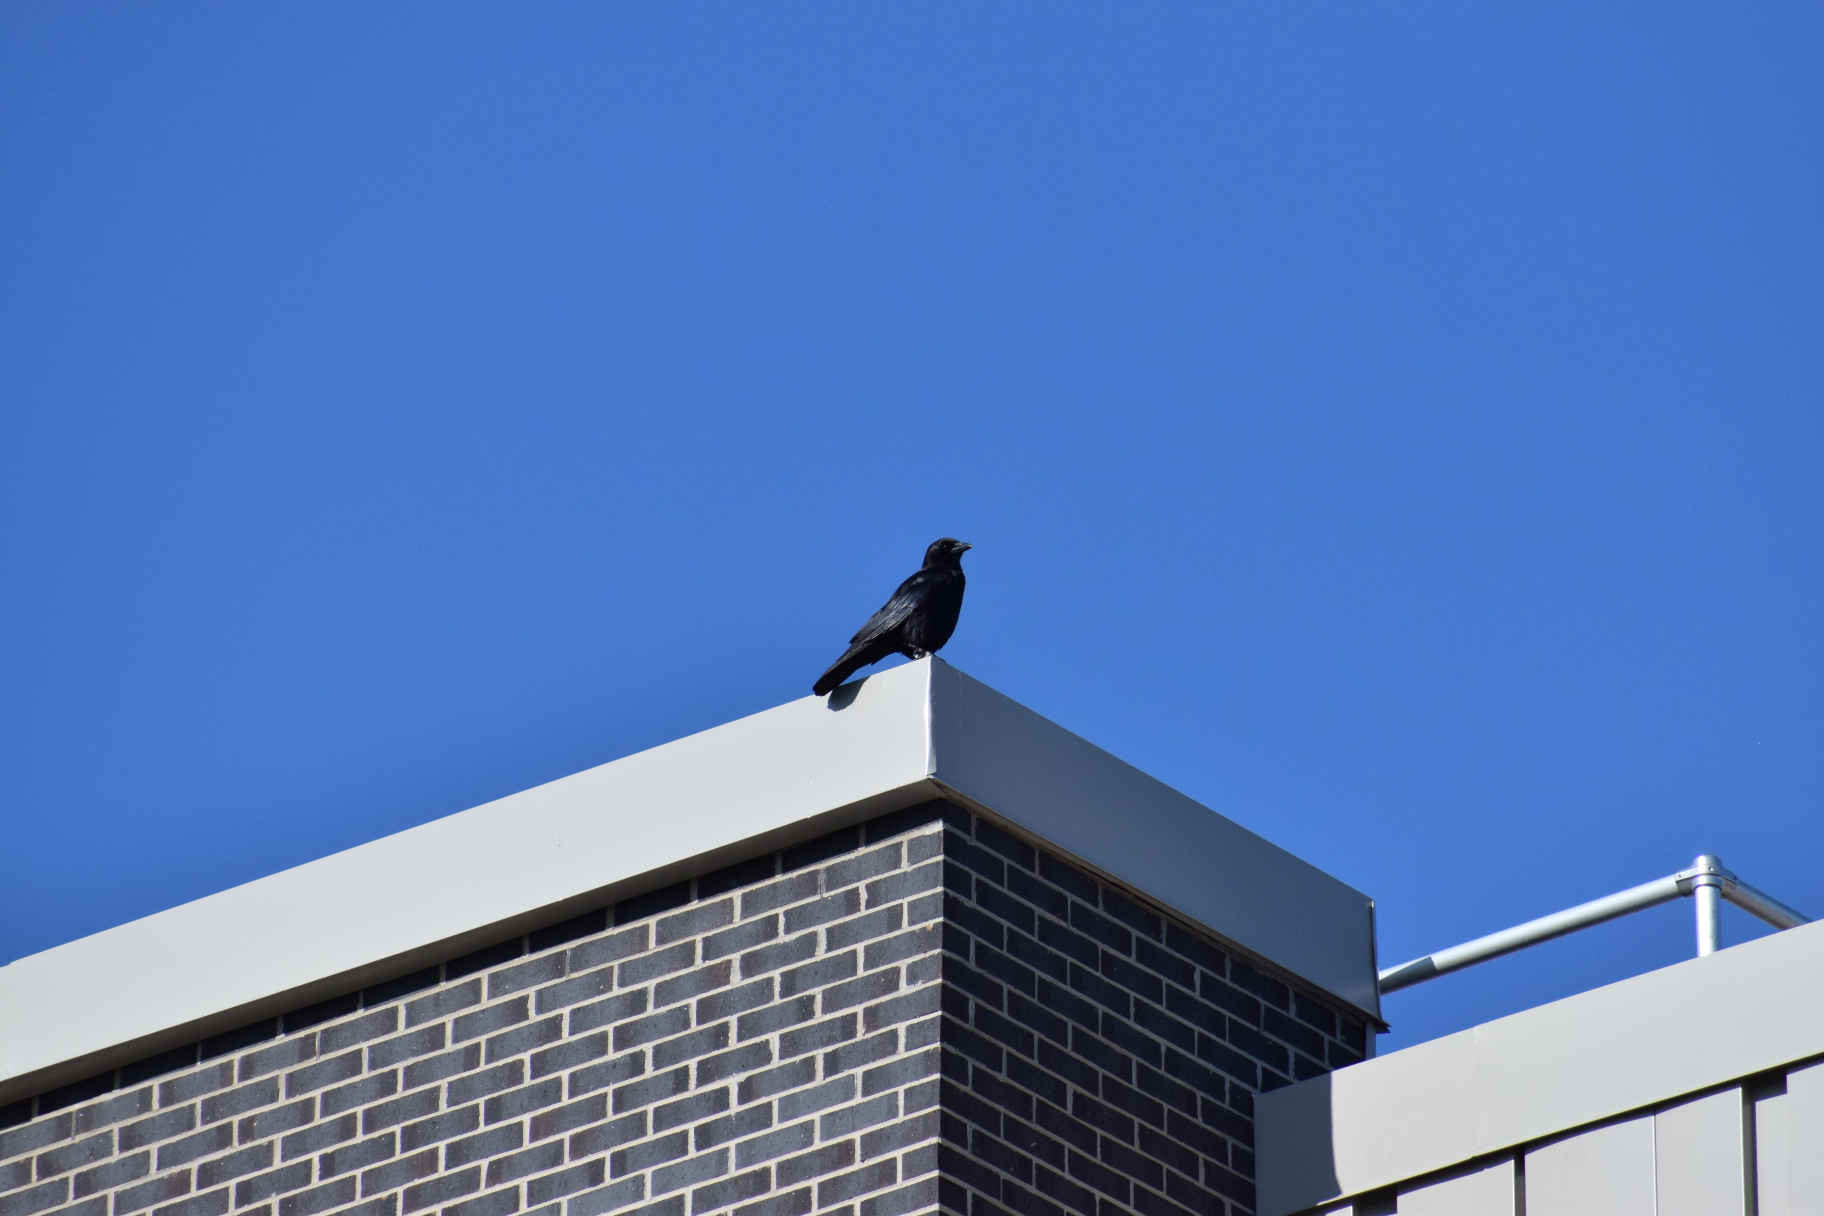

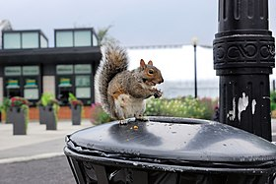
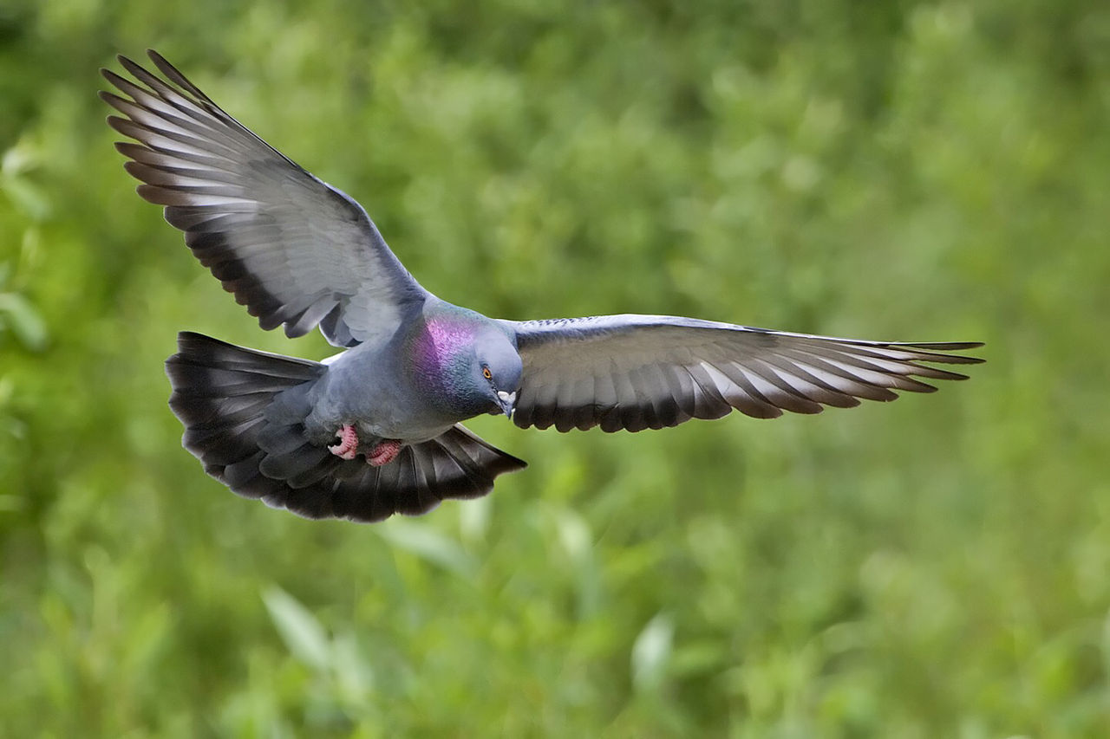
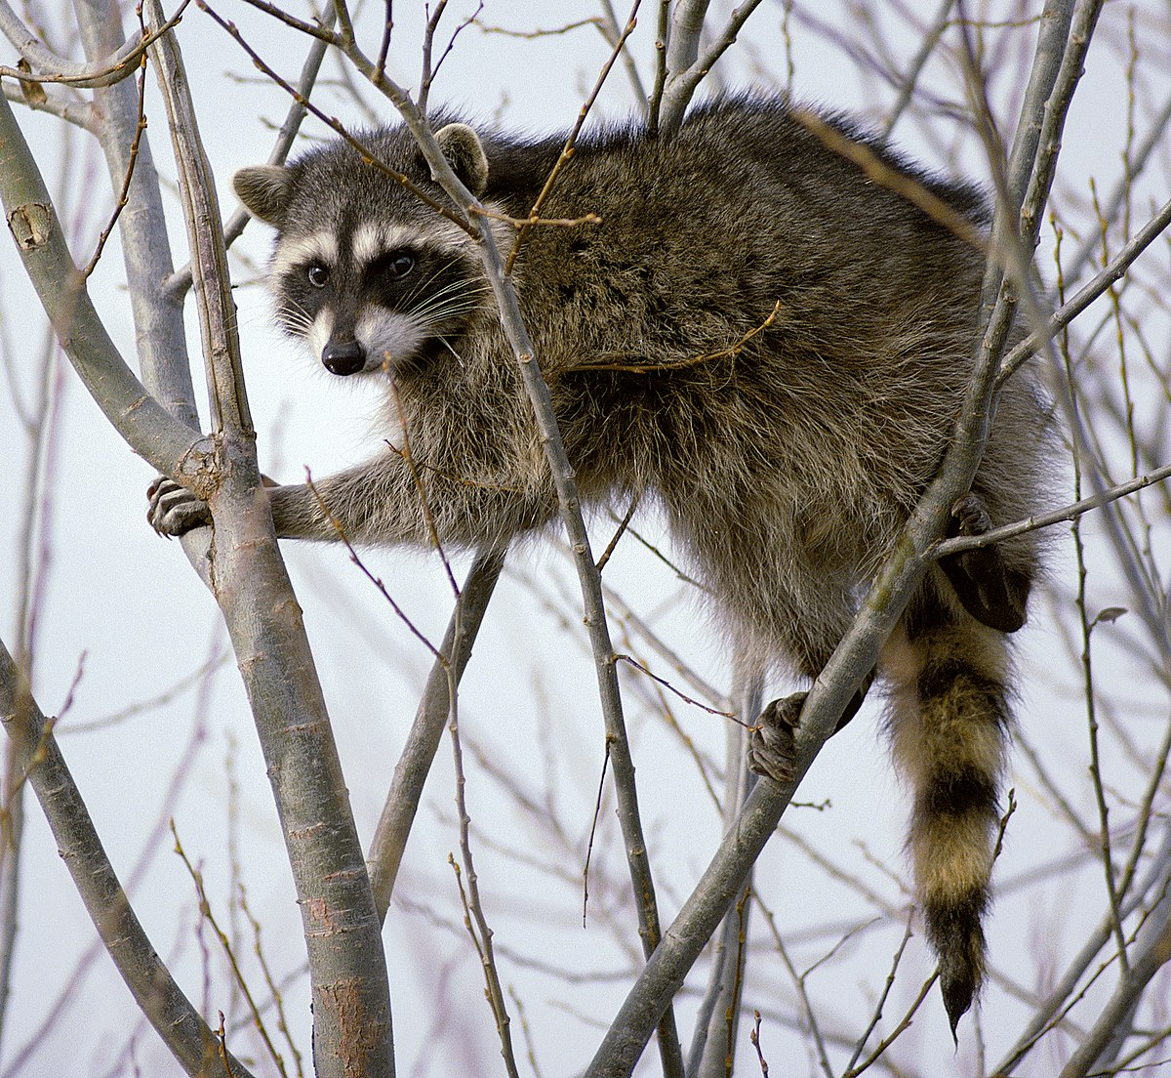
Urbanized species
Urbanization ↑ = Abundance of urbanized species↑
Adaptable
Modified diet
Generalists
Adapted behaviors
Highly Social
“Urban wildlife - squirrel.jpg” by Taxiarchos228 - LAL-1.3
“Rock dove - natures pics.jpg” by Alan D. Wilson – CC BY-SA 2.5
“Raccoon climbing in tree.jpg” by David Menke – Public Domain
Notes:
Give credits for photos.

Slide 7
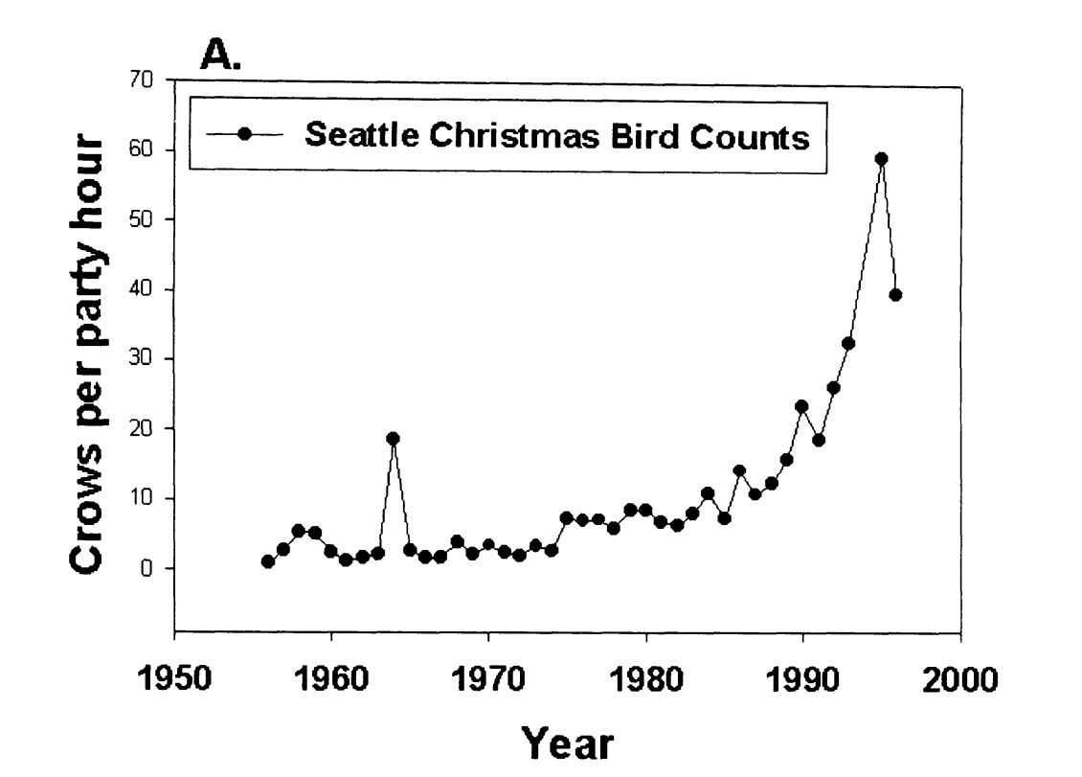
American crows in urban areas
Does the social nature of urbanized species contribute to their success in urban areas?
Crows spotted per hour
American crows (Corvus brachyrhynchos) are an ideal model to test for social behaviors in urbanized species.
Marzluff et al.(2001). Avian Ecology and Conservation in an Urbanizing World || Causes and consequences of expanding American Crow populations.
Notes:
Explain numbers. Why are the crows successful? They are urbanized. Why are they successful? Perhaps because of their social nature. That makes them a good model for this type of study.
Explain Christmas count (annual bird count)
Make this question more obvious.
Change wording to be more direct.

Slide 8
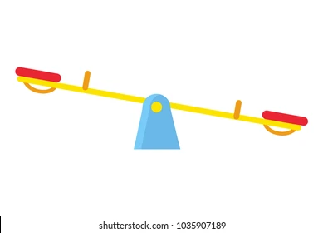

Vigilance and social foraging behavior
A trade-off between vigilance and foraging efficiency
Too much is like not enough
Social behaviors affect this tradeoff
Group foraging
Sentinel behavior
Vigilance
Foraging efficiency
Notes:
Individual level tradeoffs => tradeoff changes with social behavior

Slide 9
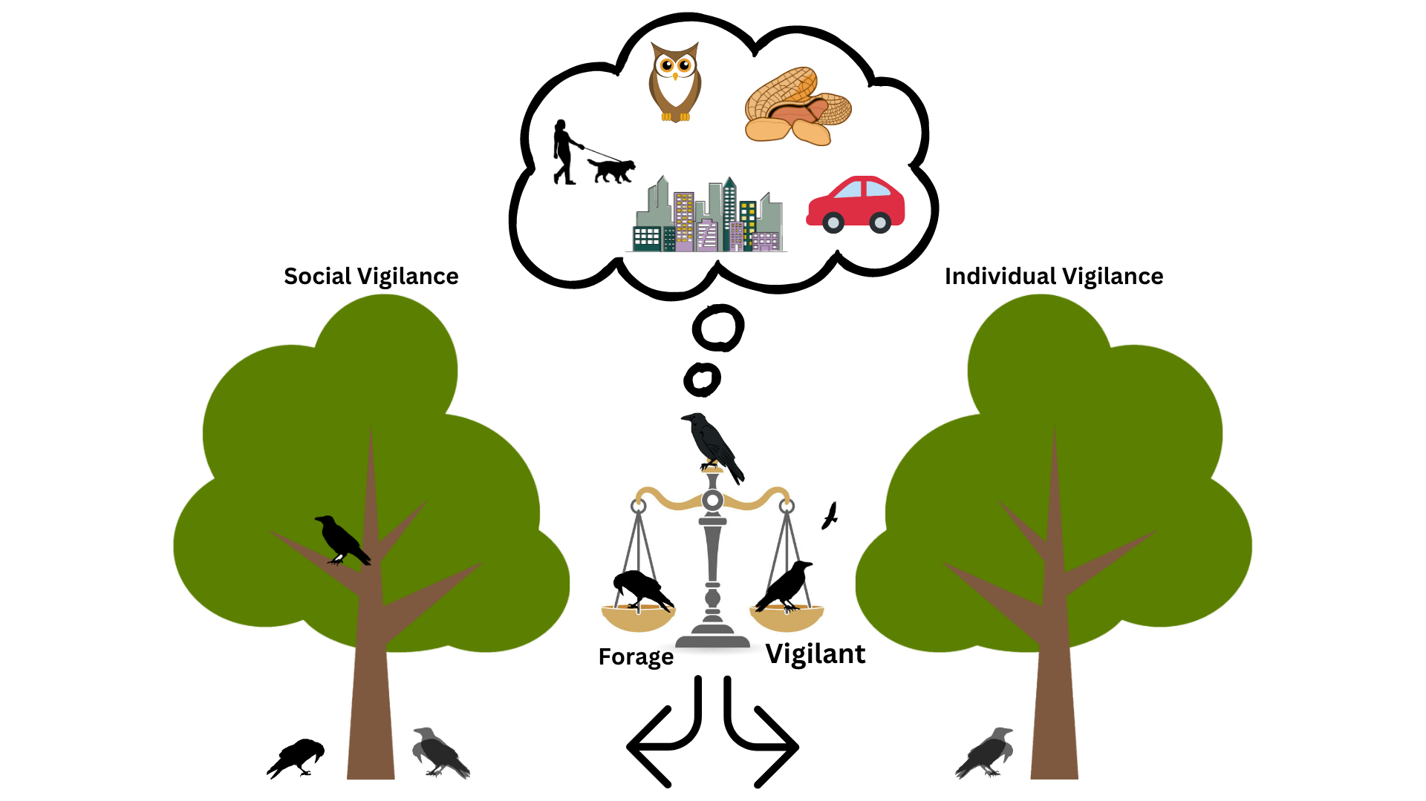
Sentinels
The sentinel ensures the protection of foraging group-members through constant vigilance.
Costly behavior to the sentinel, but very beneficial to foragers.
Social Foraging
Individual Foraging
Notes:
Prediction:
Hold your audience’s hand for the predictions. Be explicit!

Slide 10
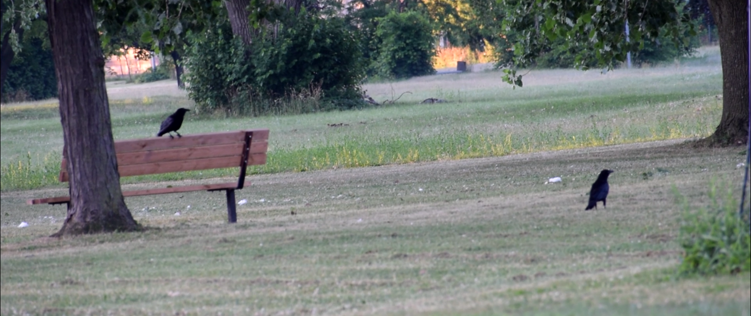
Sentinels
The presence of a sentinel is expected to reduce the vigilance of foragers.
Notes:
Hold your audience’s hand for the predictions. Be explicit!

Slide 11
My objective
Determine if an individual’s foraging vigilance affected by the presence of a sentinel and the environment in which it forages in.
The modified use of sentinel behaviors is understudied.
Could explain, in part, the success of American crows in urban areas.

Slide 12
Research questions
Does the presence of a sentinel and the environment affect the allocation of time to behaviors in foragers?
Does the presence of a sentinel and the environment affect the foraging efficiency of foragers?
Does the presence of a sentinel and the environment affect the duration of behavioral instances?
Increased proportion of time allocated to foraging when a sentinel is present and in green areas.
Increased peck rate when a sentinel is present and in green areas.
Increased duration of instances in the presence of a sentinel and in green areas.

Slide 13
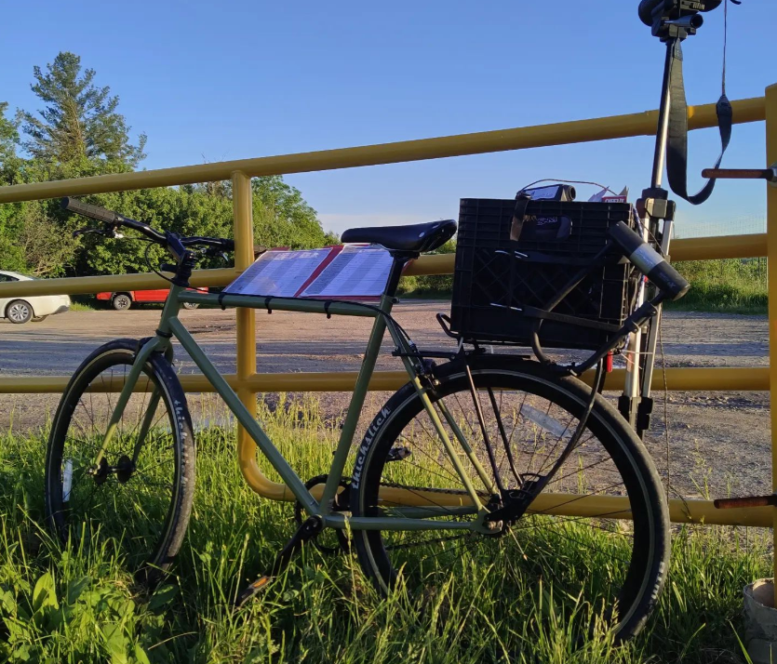
Methods
Testing sites were selected through a community science initiative: Crowkémon Go
Notes:
Explain verbally WHY you baited the sites.

Slide 14
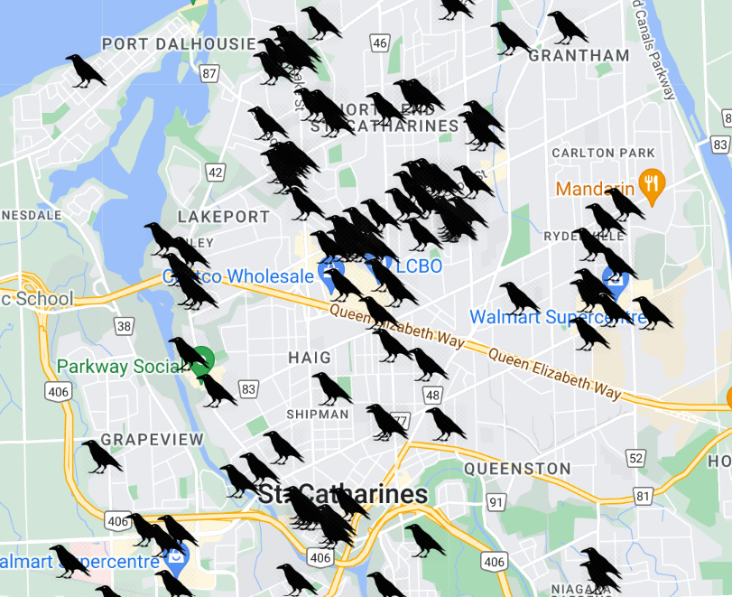
Crowkemon Go
Started in Jan 2022
Participants across the Niagara region were invited to mark the locations of crows.
Notes:
Be concise!

Slide 15
Methods
Testing sites were selected through a community science initiative: Crowkémon Go
Sites were visited and baited regularly in the morning or evening
Foraging bouts were video recorded from a distance and coded at a later date
Notes:
Explain verbally WHY you baited the sites.
Add photo of myself/crowmobile

Slide 16
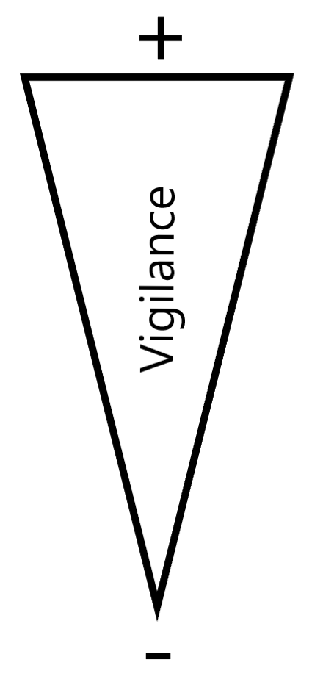
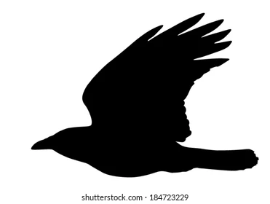
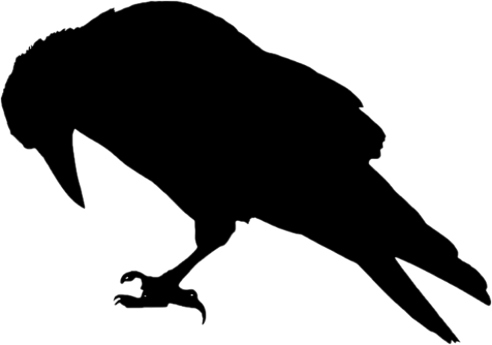
Methods
Alert
Moving
Foraging
Notes:
Can’t tell what the crow is looking at when moving (verbal)

Slide 17
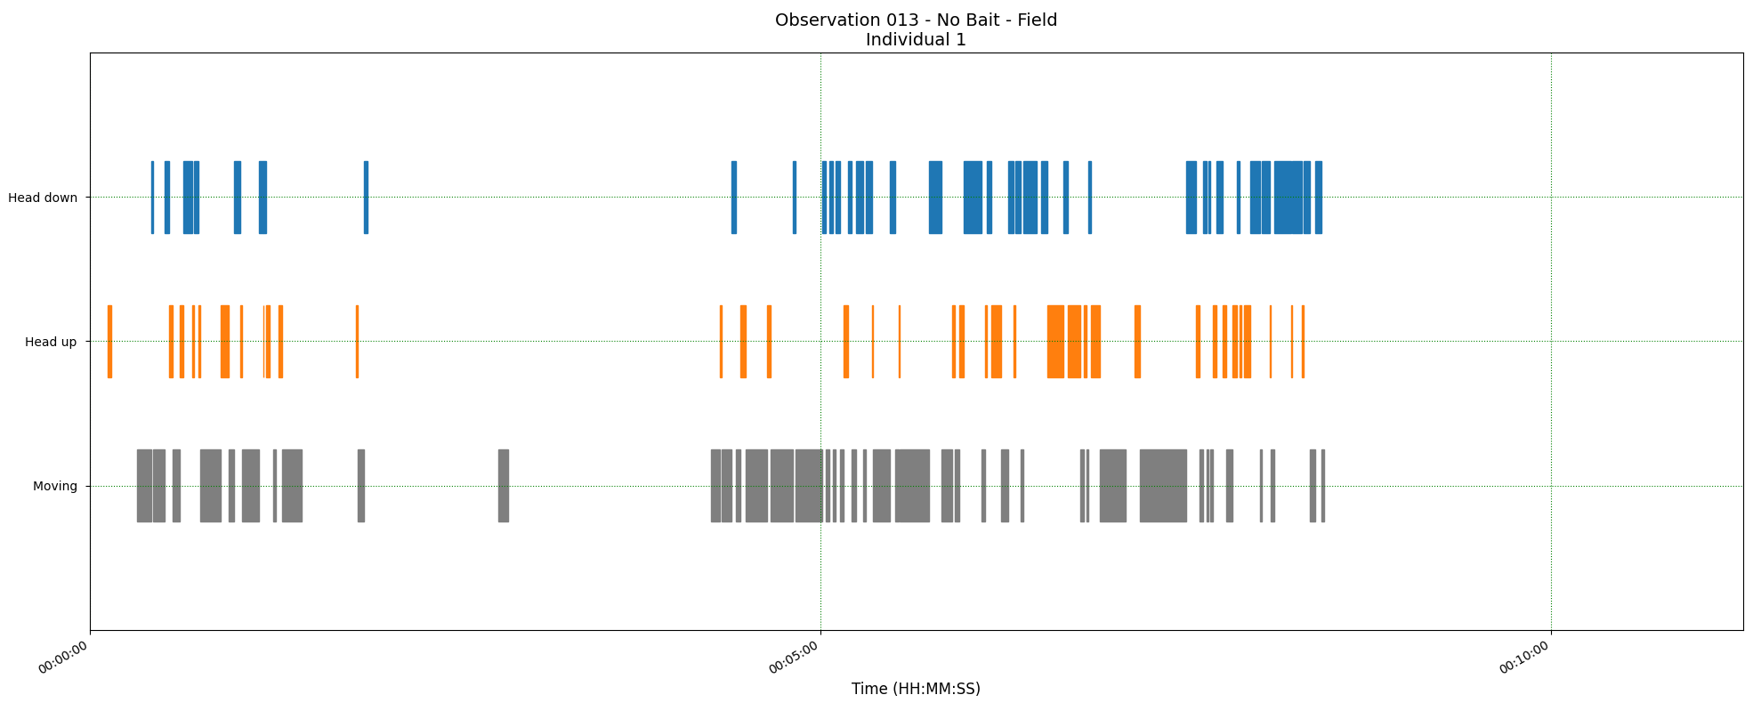
Methods
Three measurements:
The proportion of time allocated to each behavior
Peck rate
Duration of behavioral instances
Foraging
Alert
Moving
Time
Notes:
Explain what these measurements are.
DO NOT MENTION BORIS!!!

Slide 18
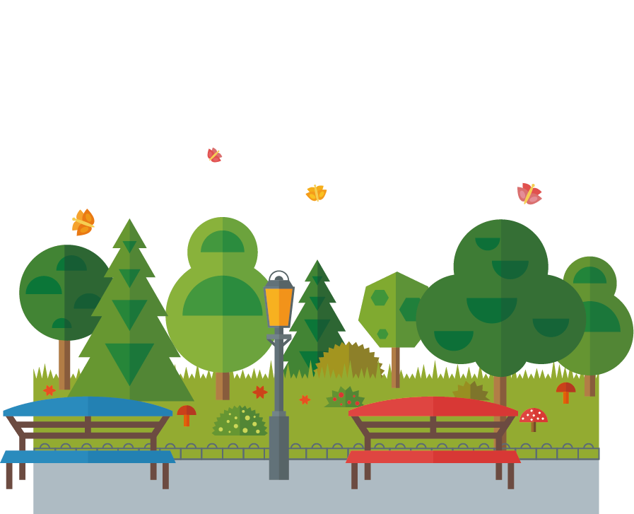

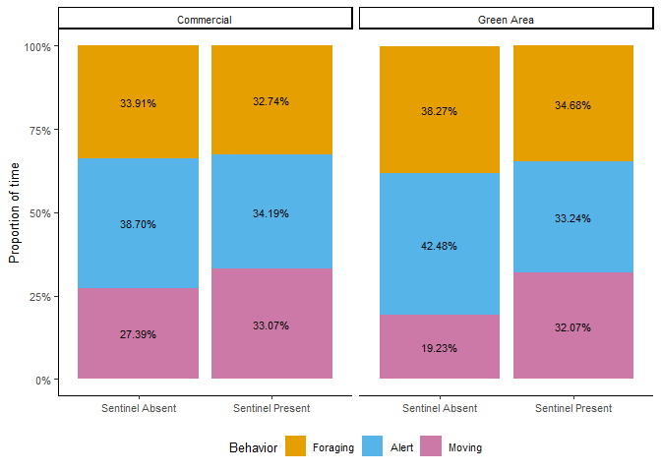
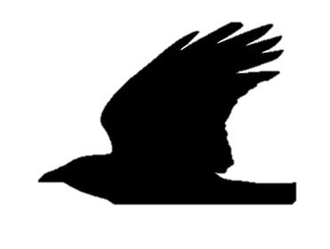
Proportion of time
Contrary to my predictions, there were no significant effects!
Proportion of foraging time
Notes:
Remove gridlines! (Go back in R, theme_classic())
Add in-between slide with thesis questions, bring it up as you answer the questions.

Slide 19
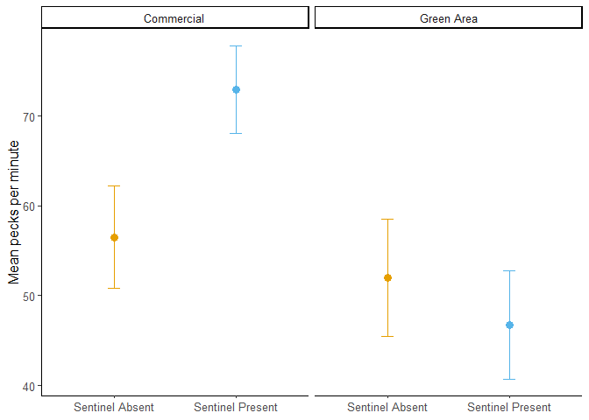
Peck rate
The environment and the presence of bait had a significant effect, but not the presence of a sentinel.
Peck rate higher in commercial areas.
Mean Pecks per Minute
Notes:
Add boxes in R (Facet_grid), add images on the top.
Remove numbers.

Slide 20
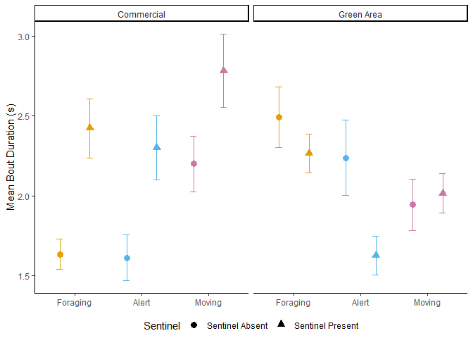
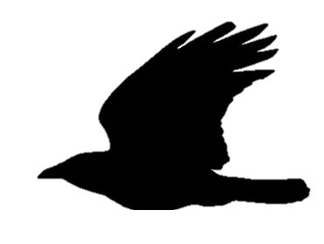
Instance duration
The behavior, the environment, the presence of a sentinel and the presence of bait had a significant effect on the duration of behavioral instances.
An interaction between the presence of a sentinel and the environment also had a significant effect.
Mean Behavioral Instance Duration (s)
Absent
Present
Notes:
Explain plots first, then bring in data
Add boxes in R (Facet_grid), add images on the top.
Explain moving, give take-home message, add tiny figures in your image.
Block out behaviors on images if not talking about them

Slide 21
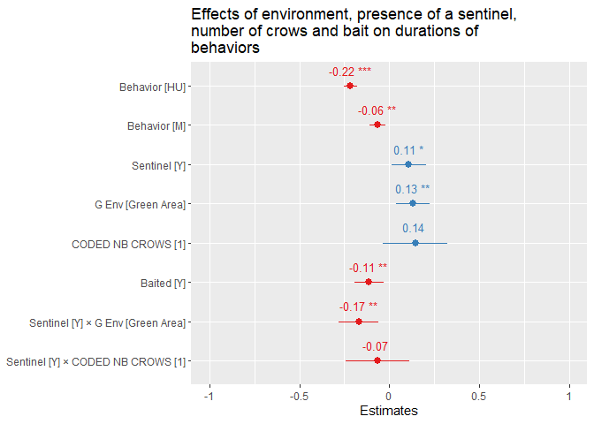
Effect sizes
Both the presence of a sentinel and green areas increase the duration of behavioral instances…
But their interaction decreases it.
Bait decreases the duration of instances
Notes:
Explain what this is. These are effect sizes! If it doesn’t cross 0, it is significant.

Slide 22
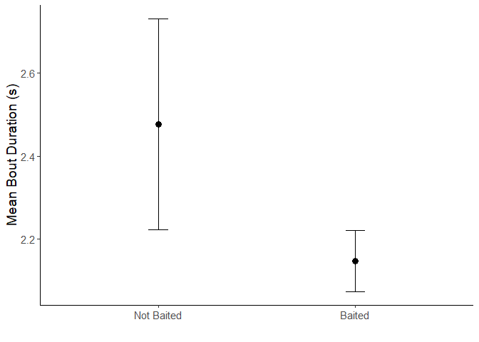
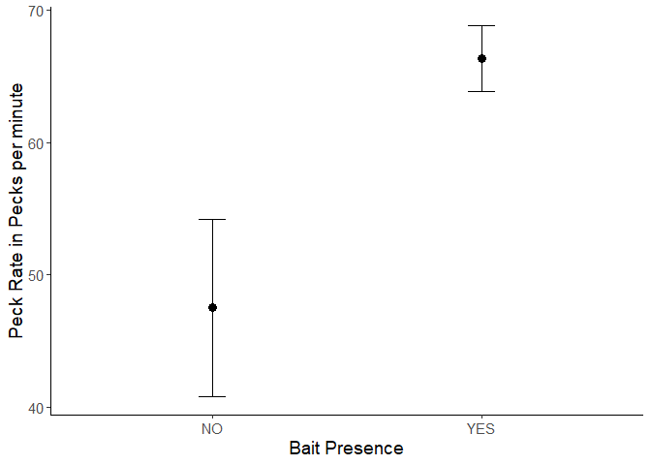
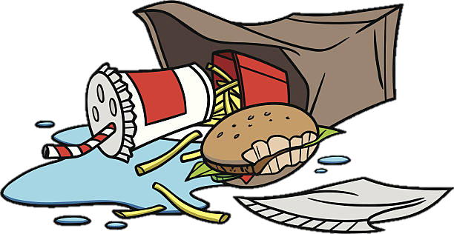
Bait
Mean Foraging Instance Duration (s)
Baited sites had significantly shorter foraging instances yet faster peck rates.
Concentrated, food-dense patches
Less time looking for and handling food, but greater foraging efficiency.
Mean Pecks per Minute
Notes:
Remove numbers

Slide 23
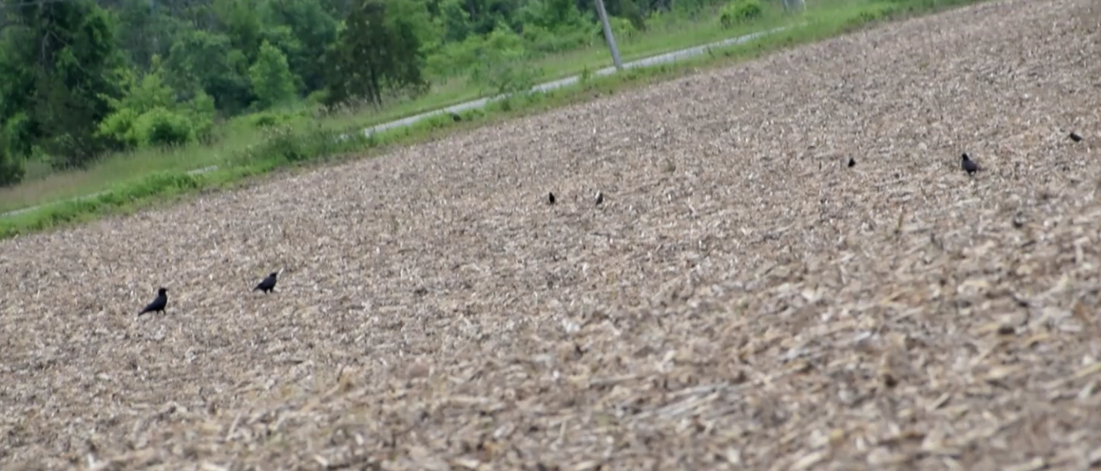
Some caveats
It is impossible to tell what the crows are looking at when being alert:
Looking for threats and predators
Other species
Other crows
Did they find something?

Slide 24


Research questions
Does the presence of a sentinel and the environment affect the allocation of time to behaviors in foragers?
Does the presence of a sentinel and the environment affect the foraging efficiency of foragers?
Does the presence of a sentinel and the environment affect the duration of behavioral instances?
Increased proportion of time allocated to foraging when a sentinel is present and in green areas.
Increased peck rate when a sentinel is present and in green areas.
Increased duration of instances in the presence of a sentinel and in green areas.

Slide 25

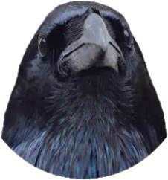
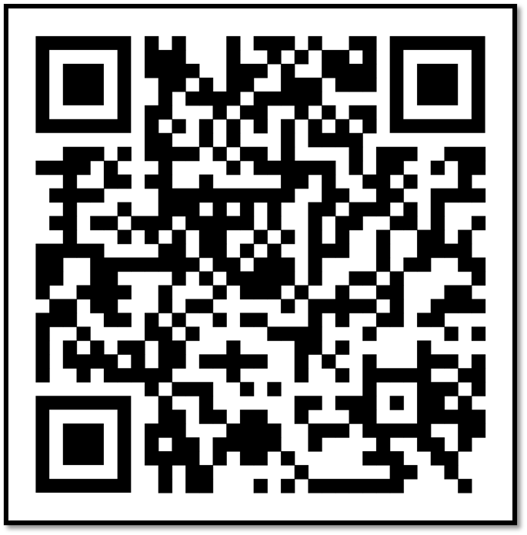

Crowkémon Go

Slide 26
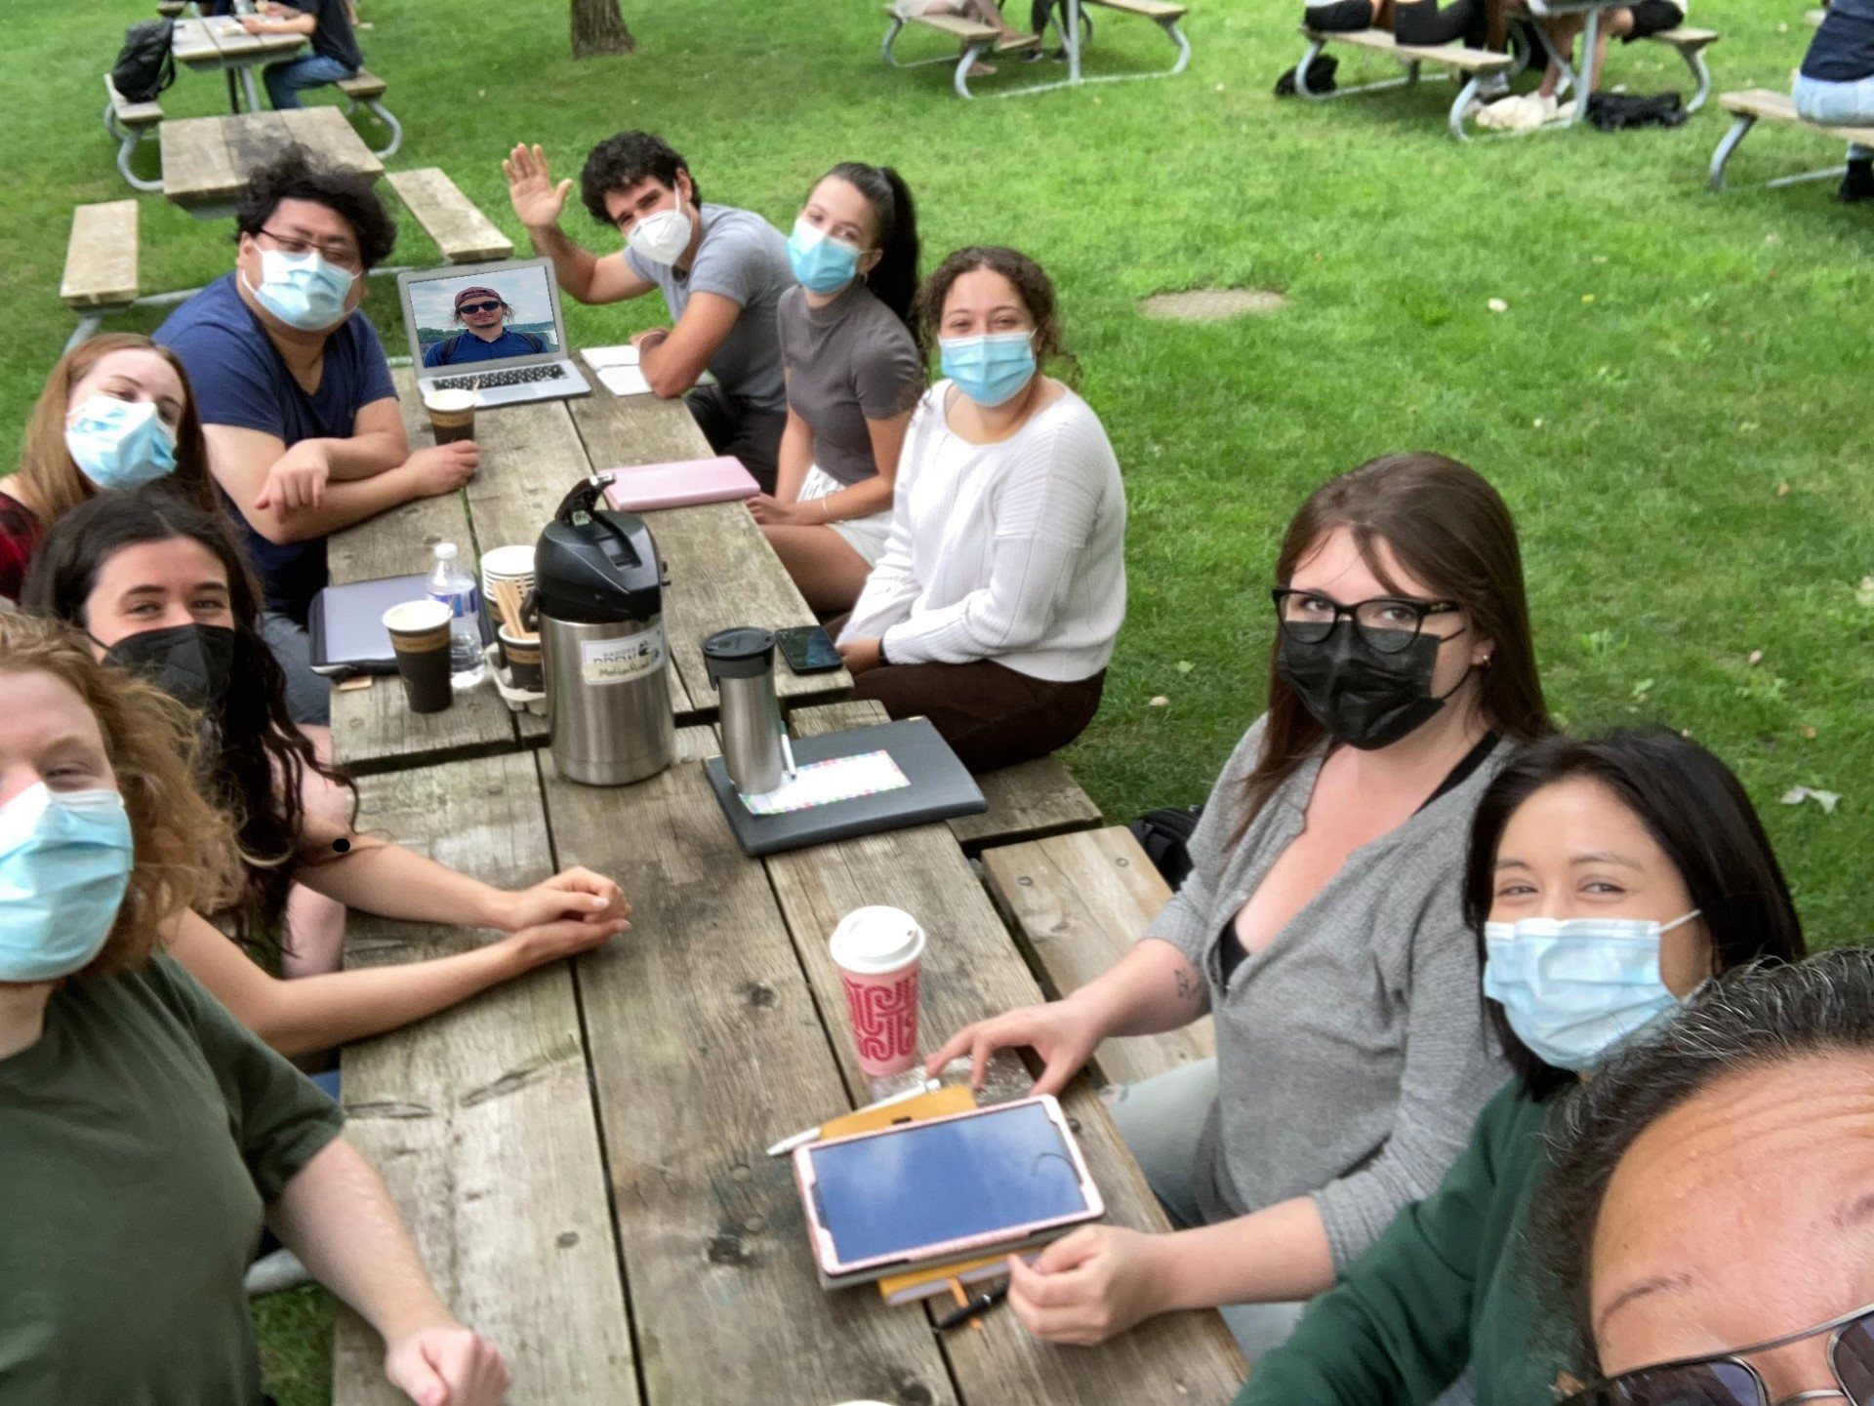

Acknowledgements
My supervisors: Dr. Kiyoko Gotanda, Dr. Liette Vasseur, Dr. Anne Clark
The Gotanda Lab
My family and friends
Notes:
Ask Lex for photoshopped image.

Slide 27
Questions?
Scan this to learn more about Crowkémon Go

